Slide 1
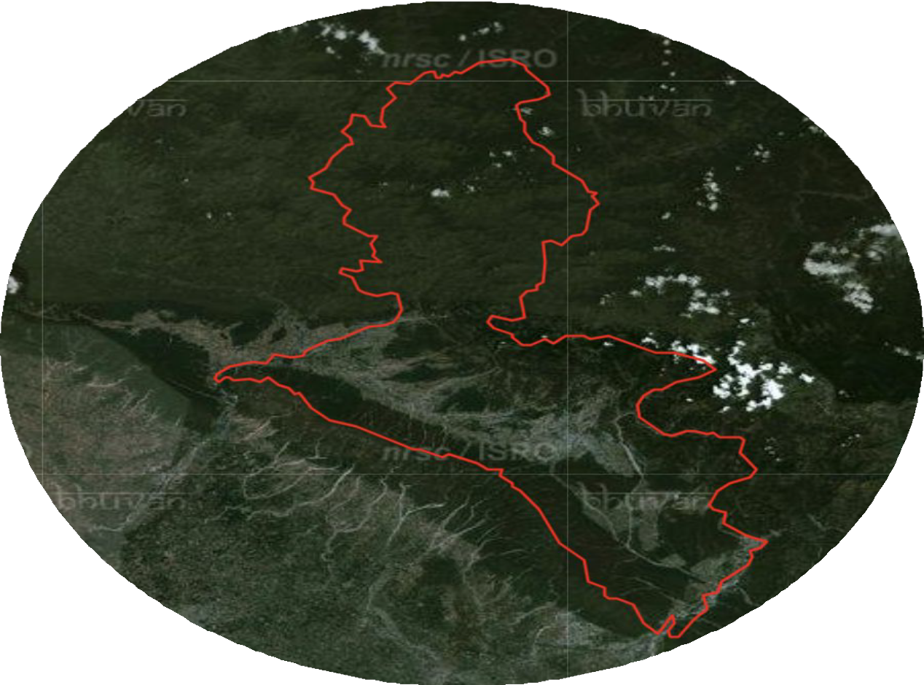
ACCESSING DEFORESTATION BY USING SATELLITE IMAGINARY IN DEHRADUN DISTRICT
Dehradun
UNDER THE SUPERVISION
MR. RAMESH KUMAR

Slide 2
INTRODUCTION
Deforestation is a critical environmental issue that significantly impacts biodiversity, climate change, and human livelihoods.
Accurate mapping and monitoring of deforestation are essential for effective forest management and conservation strategies.
This project aims to develop a comprehensive deforestation mapping approach focusing on Dehradun, a district in India known for its rich forest cover.
The primary objective is to analyze changes in forest cover from 2015 to 2024 at 3-year intervals, using remote sensing and advanced geospatial techniques.

Slide 3
LITERATURE REVIEW
Dr. Rashmi Saini et el. Crop Classification On Single Data Sentinel-2 Imagery
The study used Sentinel-2 satellite imagery and machine learning (Random Forest and SVM) to classify crops in Roorkee, Uttarakhand. Random Forest achieved higher accuracy (84.22%) than SVM (81.85%). High-Density Forest was classified best, while Fodder had lower accuracy due to spectral overlap. Sentinel-2 proved effective for vegetation mapping.
2. Dr. Rashmi Saini et el. Exploring capabilities of sentinel-2 for vegetation mapping using RF
This study aims to classify crop using single date Sentinel-2 imagery in the Roorkee, district Haridwar, Uttarakhand, India. Classification is performed by using two most popular and efficient machine learning algorithms: Random Forest (RF) and Support Vector Machine (SVM).

Slide 4
3. Battude M et el. “Estimating maize biomass and yield over large areas using high spatial and temporal resolution Sentinel-2A like remote sensing data. Remote Sens Environ.”
High-resolution remote sensing data, like that from Sentinel-2A, provides valuable insights into agricultural productivity. Battude et al. (2016) demonstrated the potential of Sentinel-2A-like data to estimate maize biomass and yield over large areas, emphasizing its high spatial and temporal resolution. Their work highlights the importance of advanced remote sensing technologies in agricultural monitoring, enabling accurate predictions critical for resource management and planning.

Slide 5
PROBLEM STATEMENT
This project, "Assessing Deforestation Using Satellite Imagery in Dehradun district" aims to leverage Sentinel-2 satellite images to analyze deforestation trends from 2015 to 2024 at 3-year intervals.
By comparing forest cover across these years, the study seeks to quantify the extent of deforestation, identify affected regions, and provide a basis for understanding the drivers and impacts of forest loss.
The project's outcomes will contribute to better monitoring and management of forest resources, aiding in conservation and sustainable development efforts.

Slide 6
MOTIVATION
Deforestation poses a significant threat to ecosystems, biodiversity, and climate stability.
Traditional monitoring methods have limitations in coverage, frequency, and accuracy.
Integration of satellite imagery and deep learning offers a promising solution.
Satellite images provide real-time, high-resolution data for detecting changes in land cover.
Deep learning algorithms automate the analysis of large datasets, enhancing precision in deforestation mapping

Slide 7
OBJECTIVES
1. Deforestation Mapping
Analyze deforestation patterns in Dehradun from 2015 to 2024 at 3-year intervals using satellite imagery.
Develop detailed maps to visualize forest cover changes.
2. Comparative Analysis
Compare deforestation trends from 2015 to 2024 at 3-year intervals to identify changes and underlying causes.
Highlight the extent and impact of deforestation over time.

Slide 8
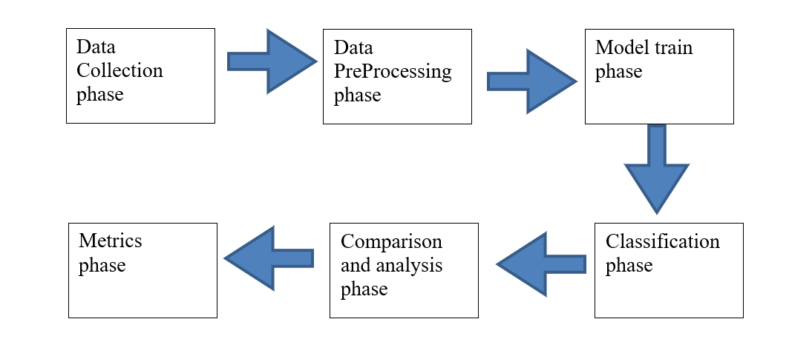
METHODOLOGY

Slide 9
IMPLEMENTATION STEPS
The project will follow a systematic approach involving:
Data collection: through sentinel-2, Copernicus.
Preprocessing: through SNAP , atmospheric correction.
Composing band: merge band (2,3,4,8) through Arc GIS.
Mosaic: merge three tiles through Arc GIS.
Masking: extracting Dehradun shape through mosaic raster.
Creating training data.
Classification: K-means, ISO Clustering, Random forest, MLC (Most Likelihood Classification), self training classifier.
Comparison: Comparison between classified images of 2015 and 2024.

Slide 10
TECHNIQUES UTILIZED
Algorithm specific model training and optimization:
K-Mean: Train and optimize K-Means clustering algorithms to identify distinct cluster of deforested and non- deforested area.
Random forest: Develop a random forest classifier using labelled satellite image to accurately classify deforestation pattern.
ISO Clustering: Implement the ISO Clustering algorithm to automatically detect clusters in satellite data.
MLC: Utilize maximum likelihood classifier to model the probability distribution of deforested and non- deforested classes and perform classification based on these probabilities.
Semi Supervised learning: Self training classifier

Slide 11
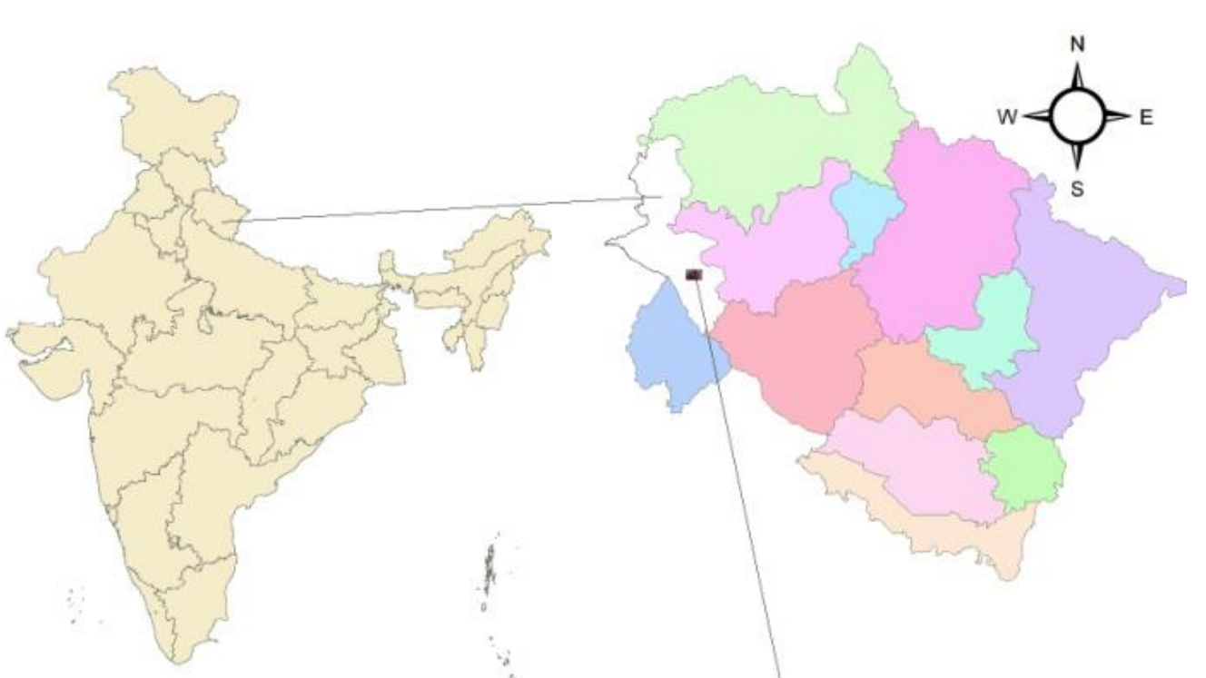
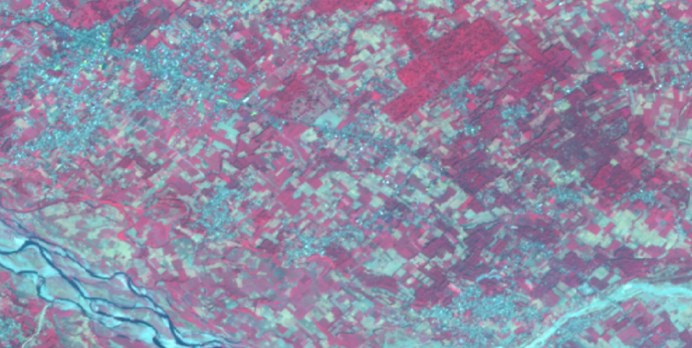
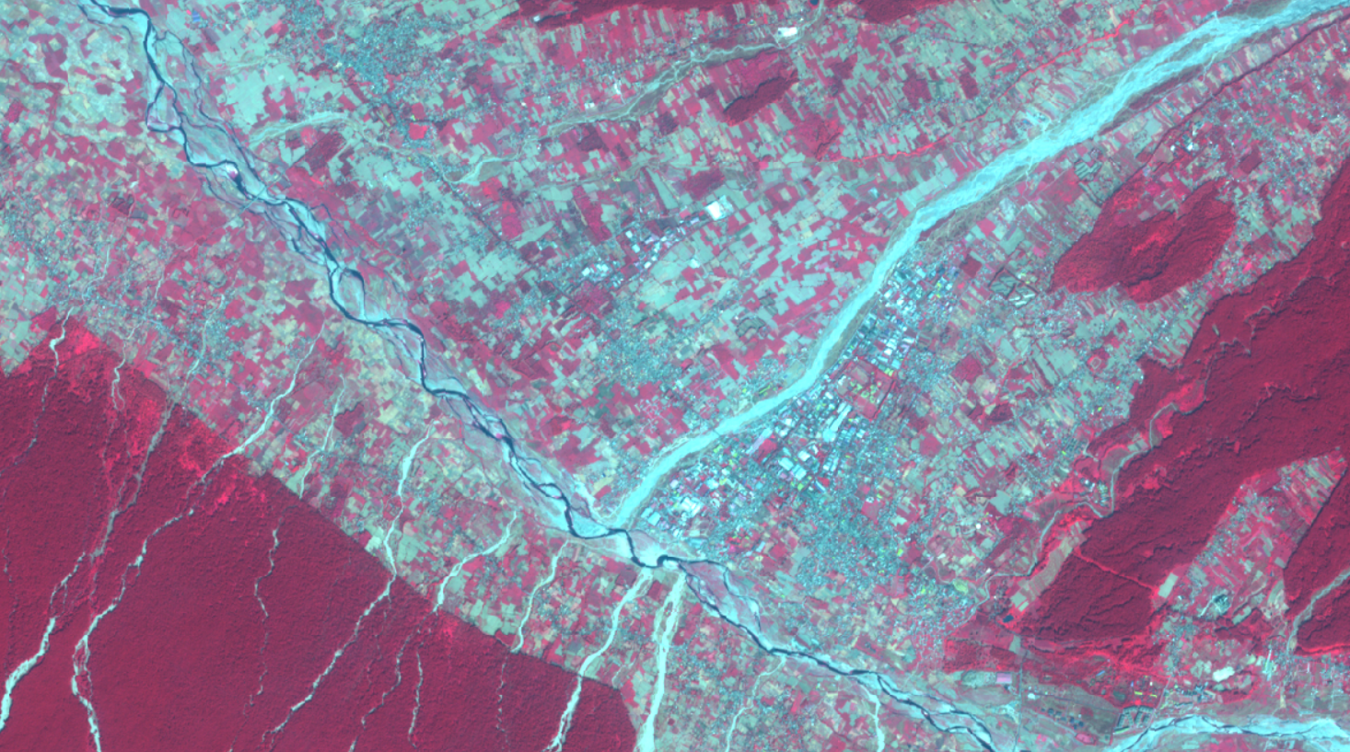
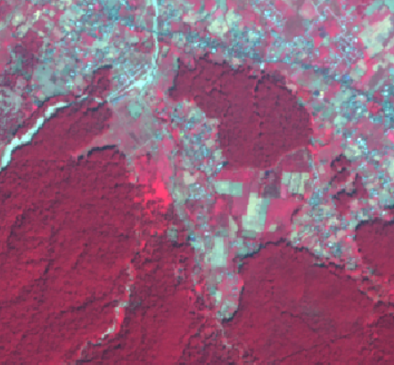
Processing of sentinel-2 data
Sentinel-2 image

Slide 12
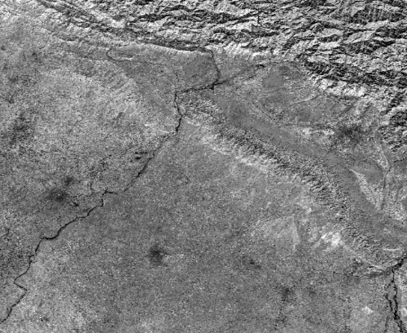
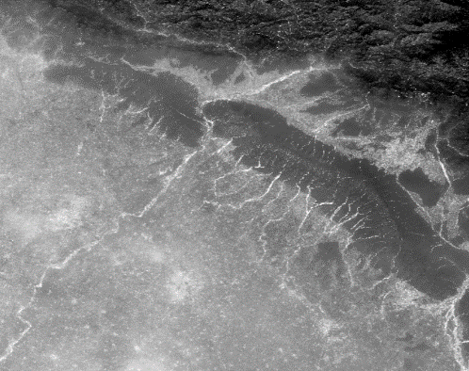
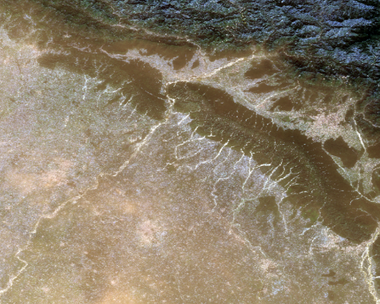
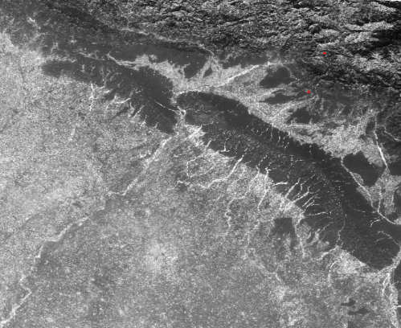
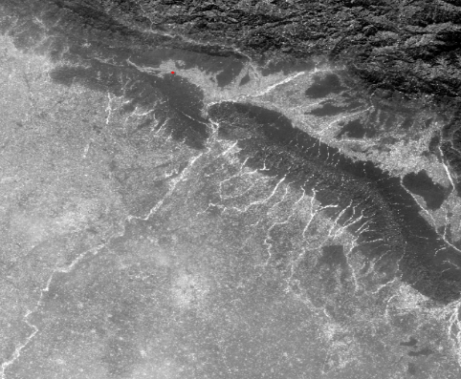
BAND 8
BAND 4
COMPOSITION
BAND 3
BAND 2

Slide 13
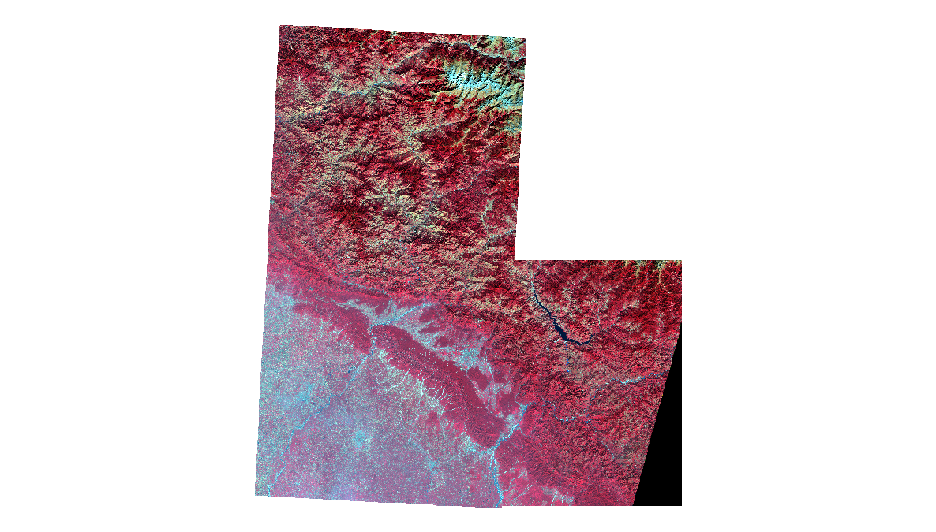
MOSAICKING

Slide 14
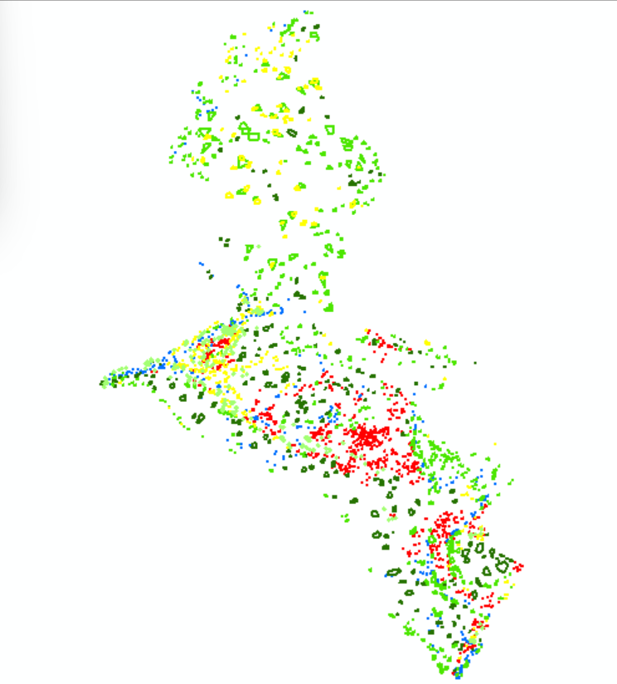
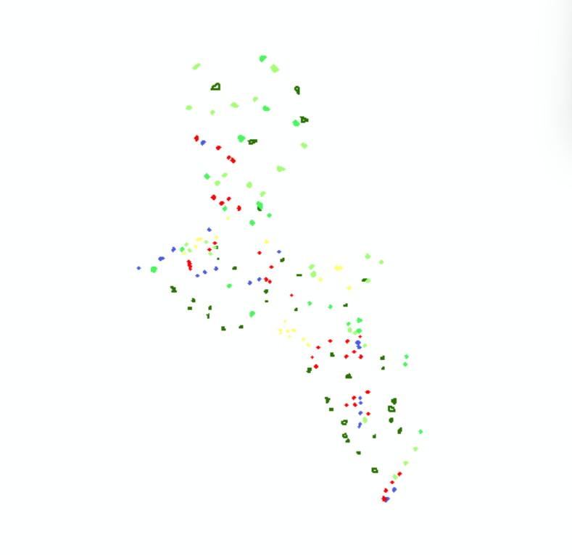
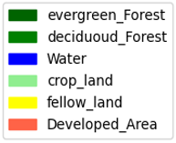
TRAINING SAMPLE LABEL
Supervised
Semi-Supervised

Slide 15
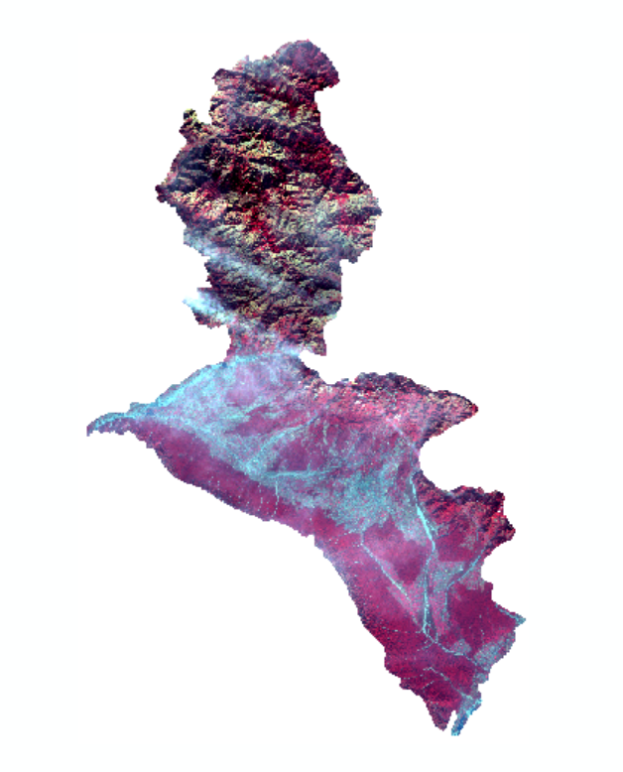
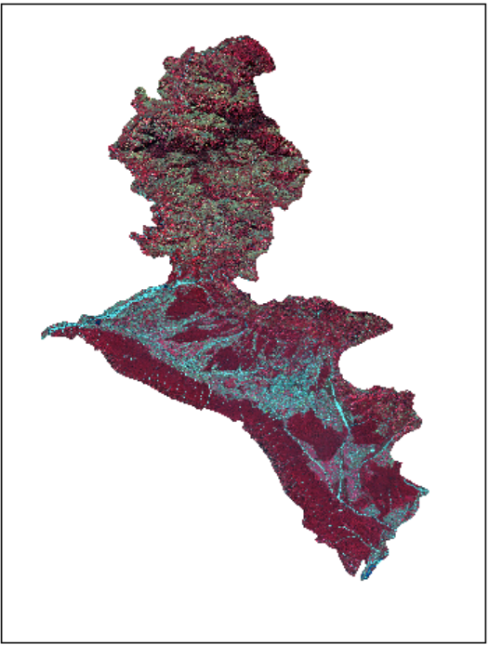
MASKING COMPARISON
2015
2018

Slide 16
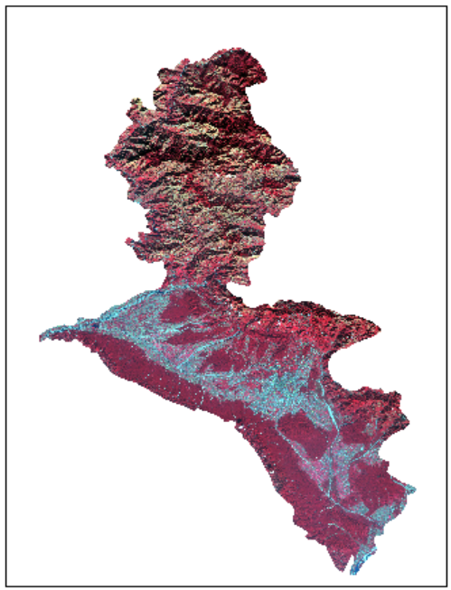
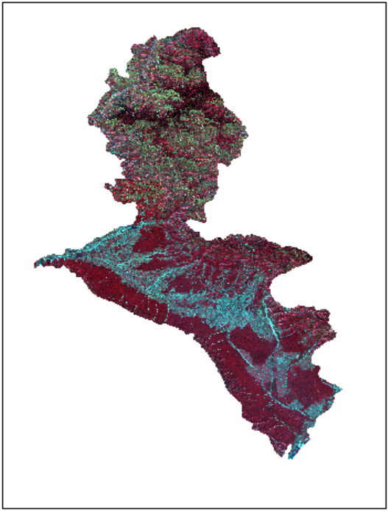
MASKING COMPARISON
2021
2024
Raster images of both year

Slide 17
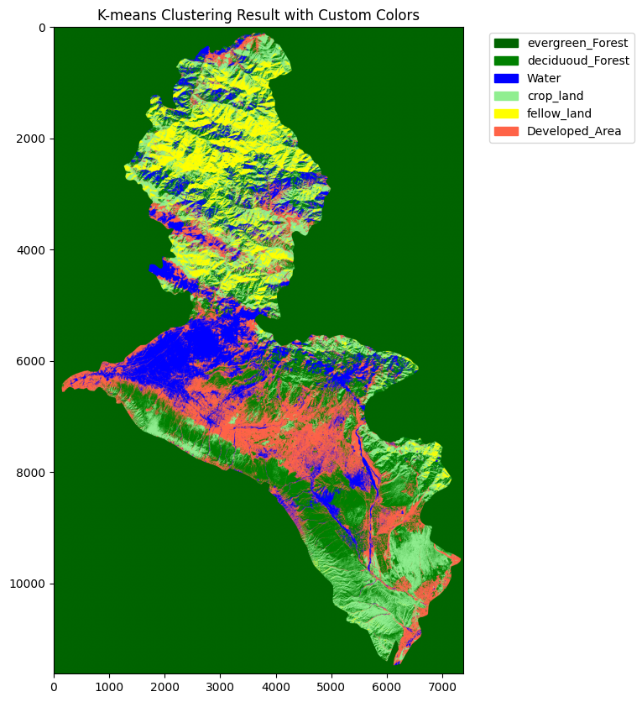
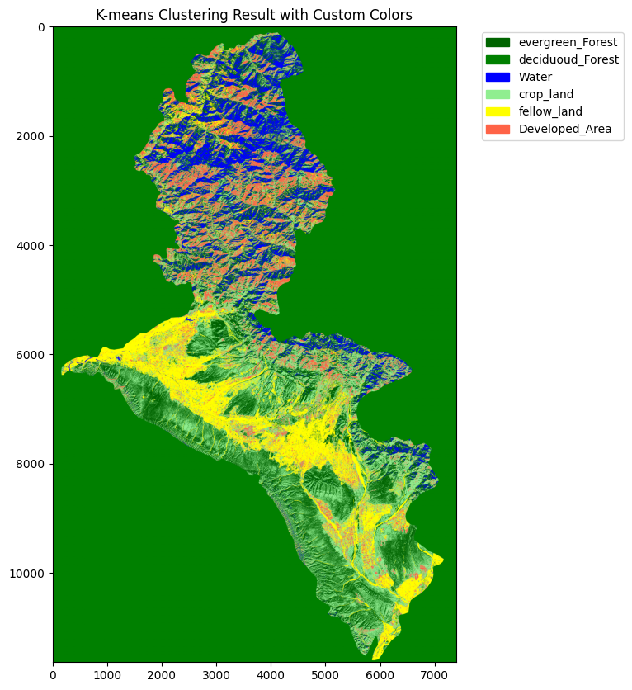
K MEANS Classification
2020
2015
Iso Clustering

Slide 18
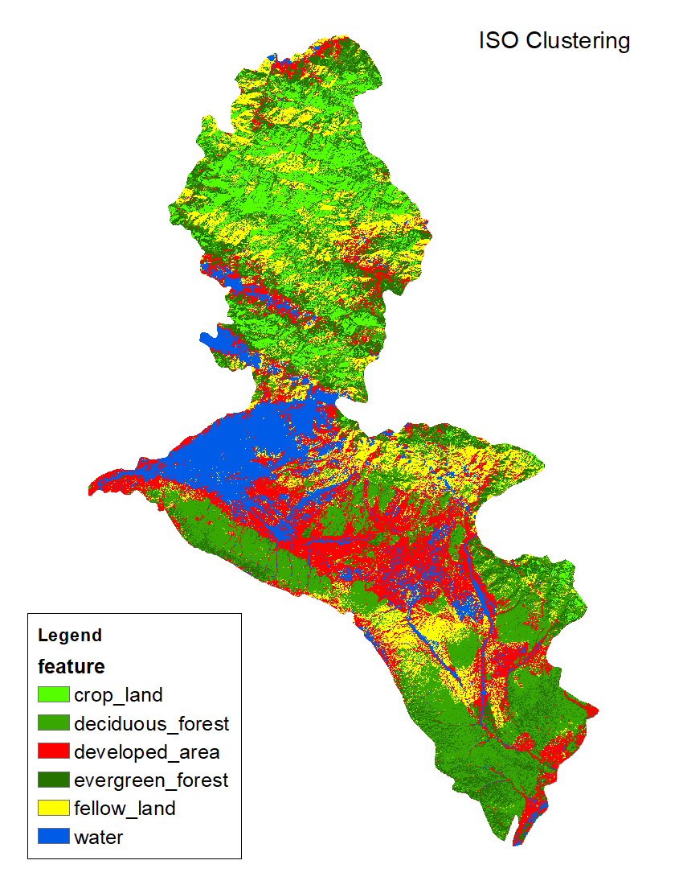
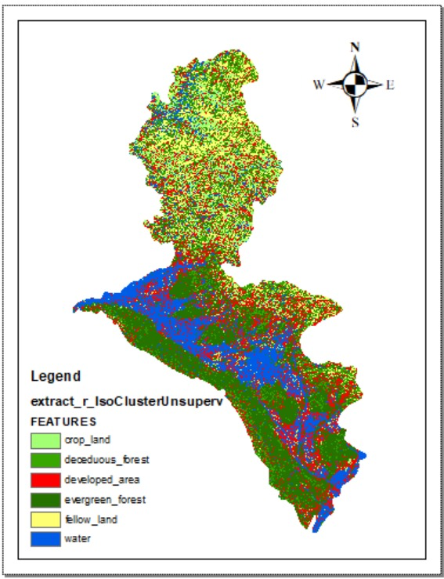
2015
ISO CLUSTERING classification image
2020

Slide 19
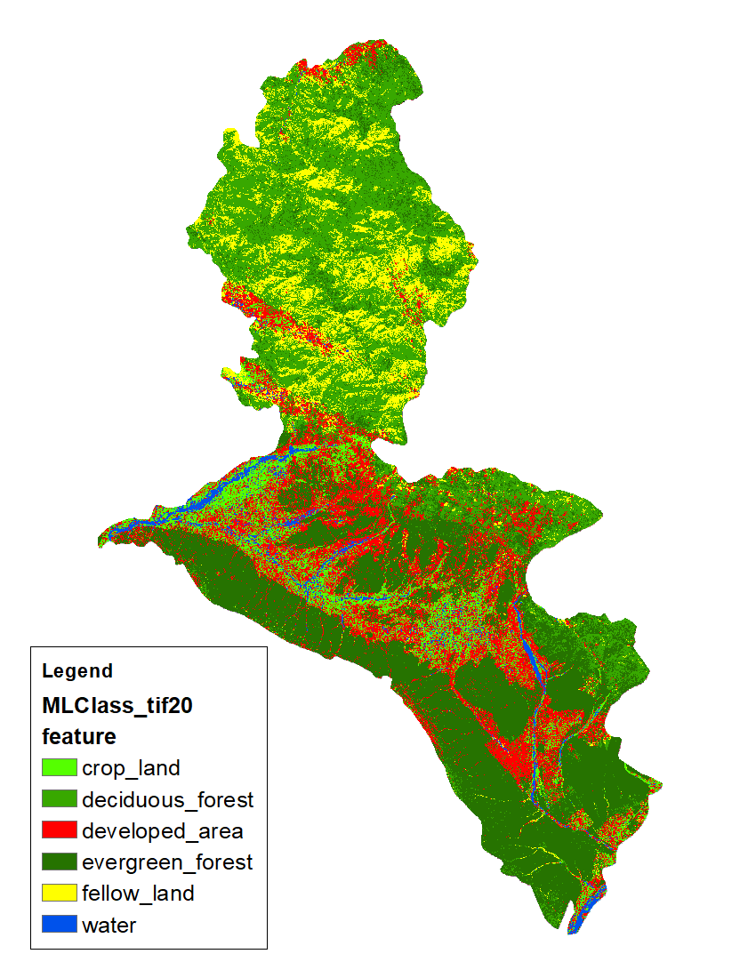
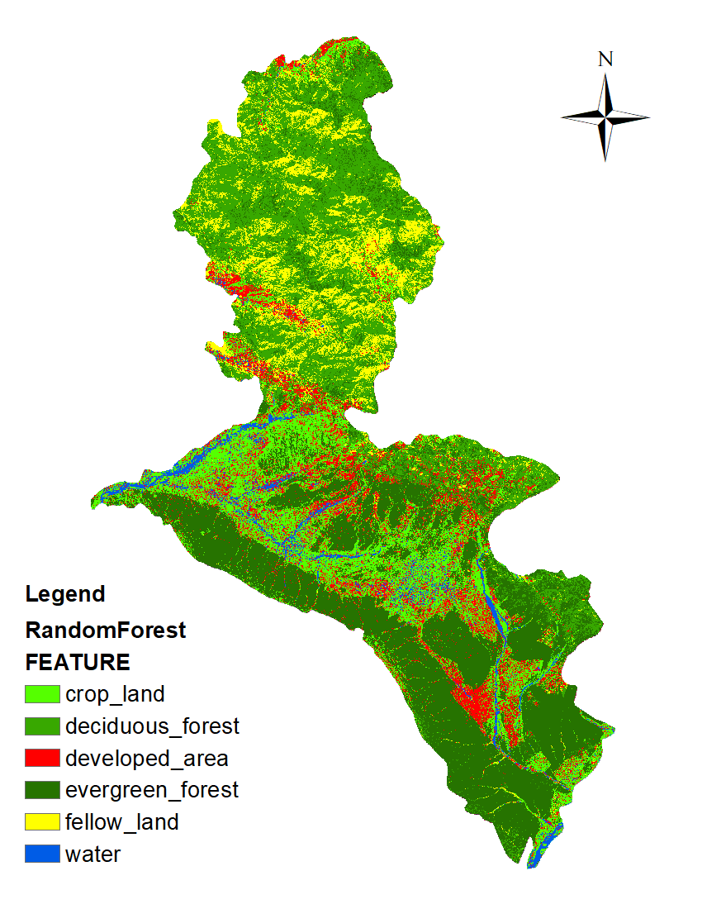
2015 Classified raster image
MLC
Random Forest

Slide 20
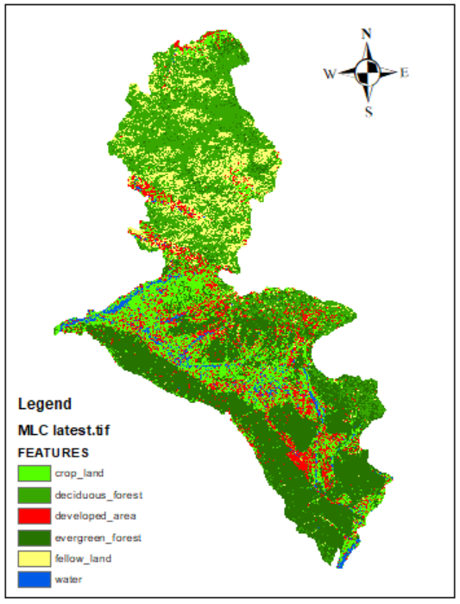

2020 Classified raster image
MLC
Random Forest
MLC
Random Forest

Slide 21
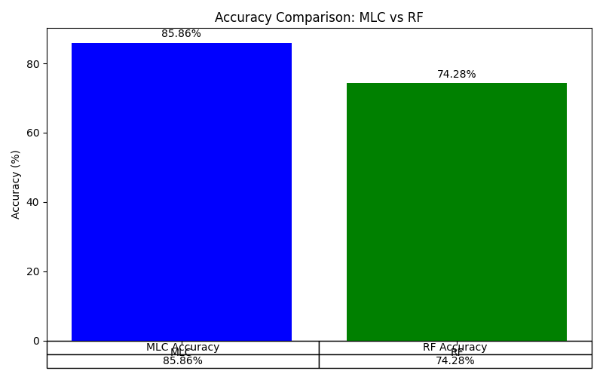
Accuracy Comparison Between MLC and Random Forest
Visual representation highlights MLC’s superior performance in this analysis.

Slide 22
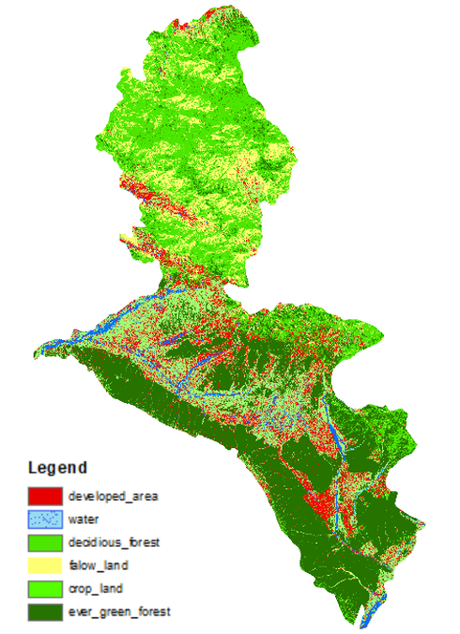
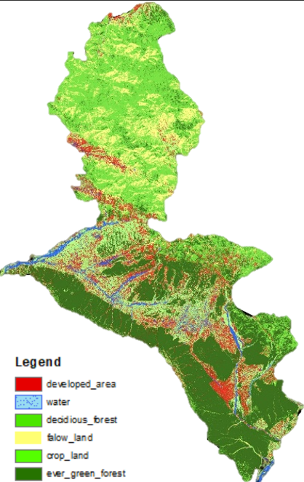
COMPARATIVE ANALYSIS
MLC 2015 MLC 2018

Slide 23
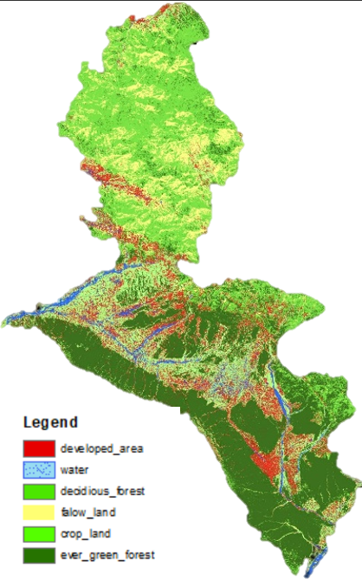
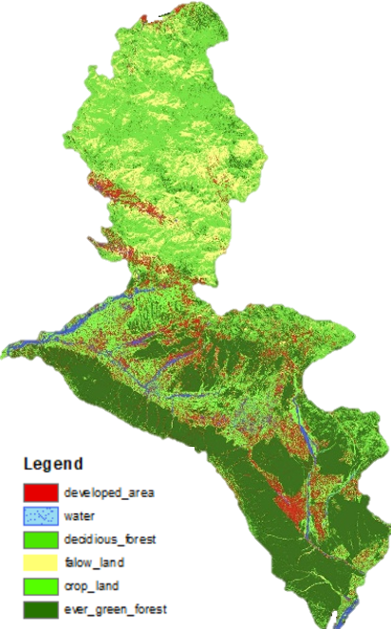
COMPARATIVE ANALYSIS
MLC 2021 MLC 2024

Slide 24
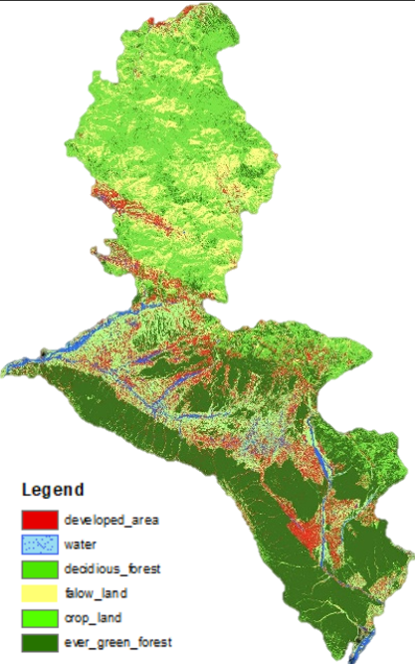
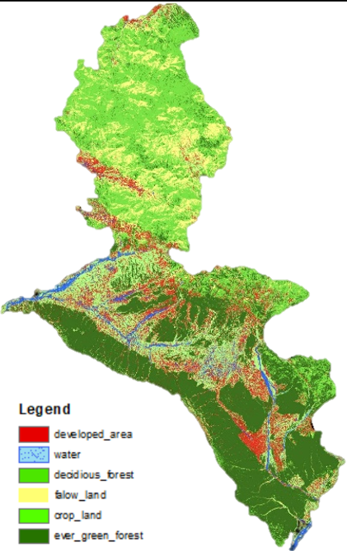
COMPARATIVE ANALYSIS
STC 2015 STC 2024

Slide 25
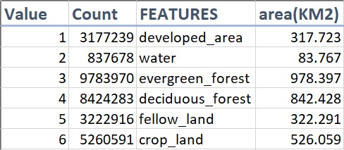
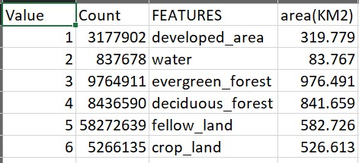
AREA COMPARISON
MLC 2015 MLC 2018

Slide 26
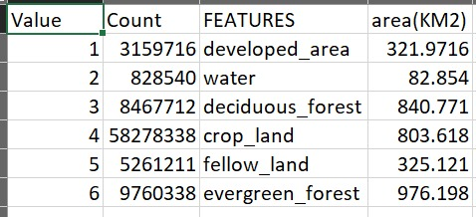
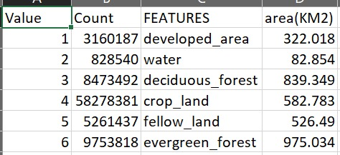
AREA COMPARISON
MLC 2021 MLC 2024

Slide 27
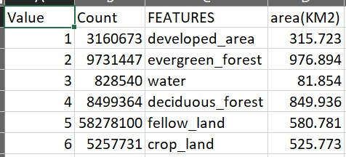
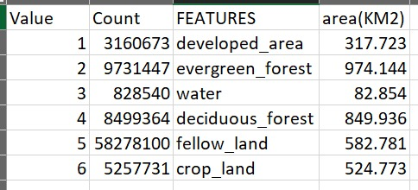
AREA COMPARISON
STC 2015 STC 2024

Slide 28
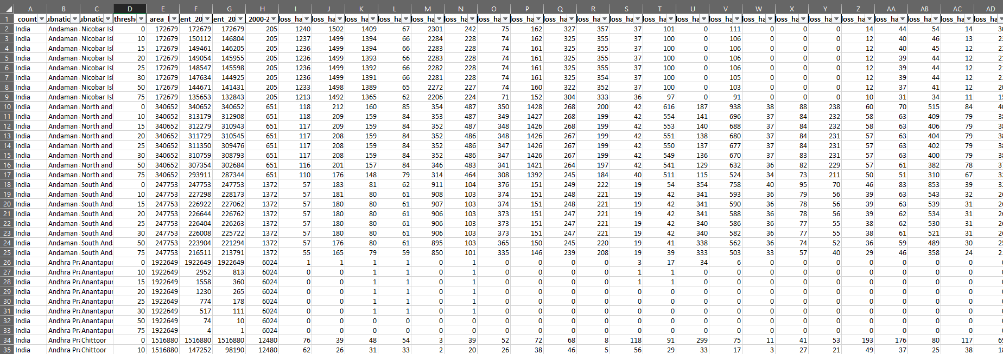
GLOBAL FOREST RESEARCH
THESE DATASET TAKES AS A GROUND TRUTH FOR OUR RESULT COMPARISON AND CALCULATE THE ACCURACY
ACCORDING TO GLOBAL FOREST RESEARCH THE DEFORESTATION FROM 2015 TO 2020 IS 222 HECTARES

Slide 29
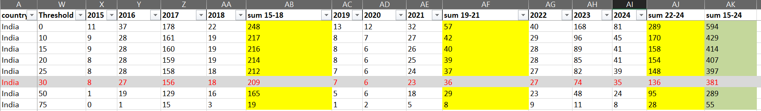
GLOBAL FOREST RESEARCH:
Extract the relevant area data from download data for further easily comparison.

Slide 30
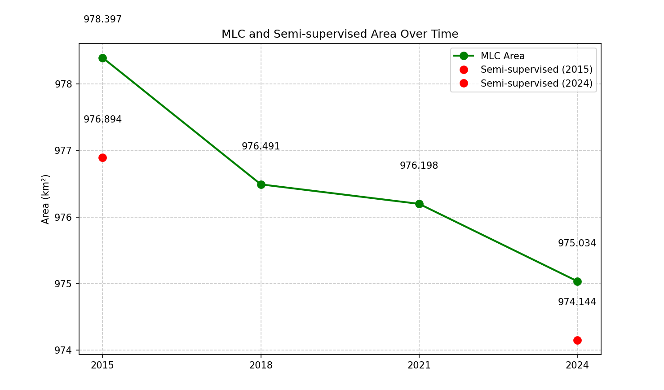
MLC vs Semi-Supervised Area Change Over Time (2015–2024)
MLC-detected area steadily declined from 978.397 km² (2015) to 975.034 km² (2024).
Semi-supervised results are marked for 2015 and 2024:
2015: 976.894 km²
2024: 974.144 km²
Both methods indicate a consistent decrease in forest cover over the years.

Slide 31
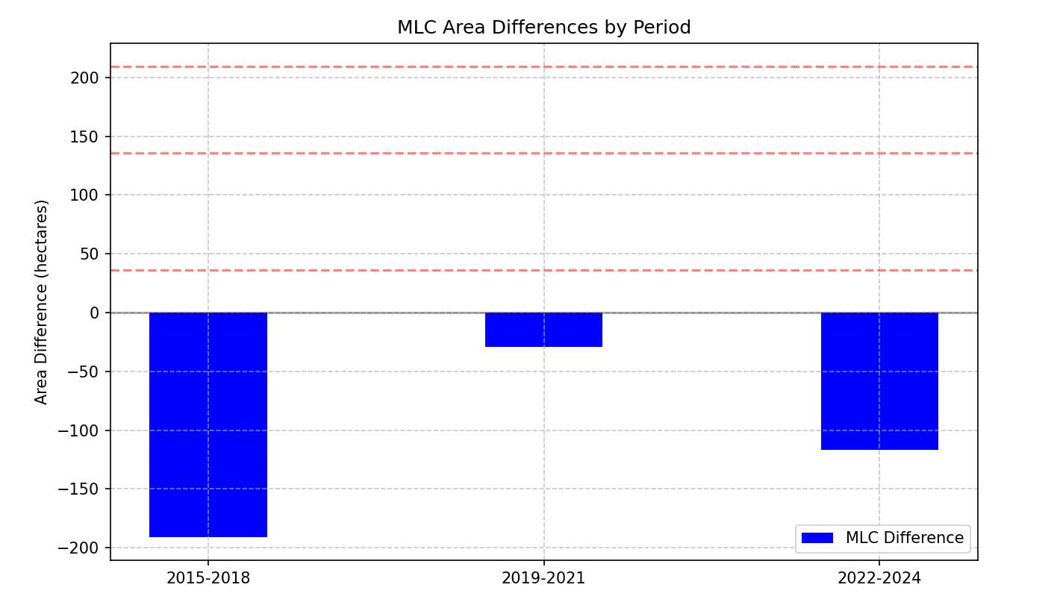
MLC Area Differences by Time Period
Bar graph shows forest area change (in hectares) between consecutive periods using MLC.
2015–2018: Largest decline of approx. −190 hectares, indicating significant deforestation.
2019–2021: Minimal decrease (~−30 hectares), suggesting a slower rate of change.
2022–2024: Notable decline resumes at ~−110 hectares.
Trend highlights fluctuating deforestation rates, with the sharpest drop in the 2015–2018 period.

Slide 32
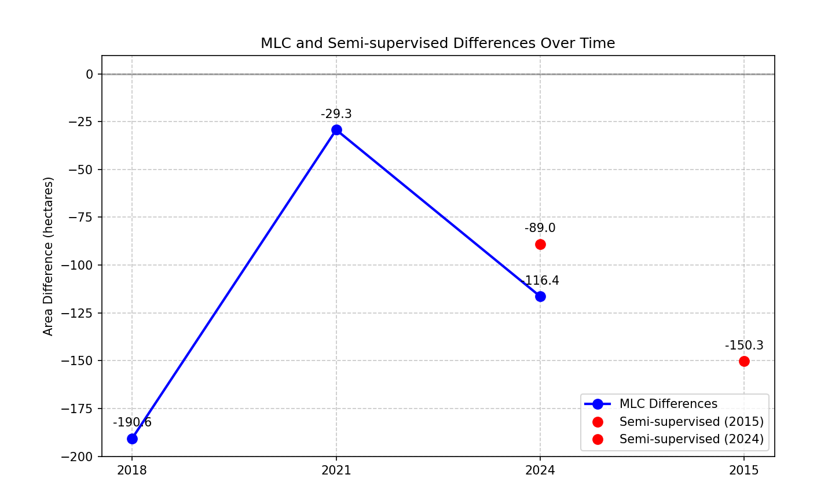
MLC vs Semi-Supervised Area Differences Over Time
Line graph displays area differences (in hectares) for MLC and semi-supervised methods.
MLC Differences:
2015–2018: −190.6 ha (largest drop)
2018–2021: −29.3 ha
2021–2024: −116.4 ha
Semi-supervised method:
2015: −150.3 ha
2024: −89.0 ha
MLC is closer to ground truth data.

Slide 33
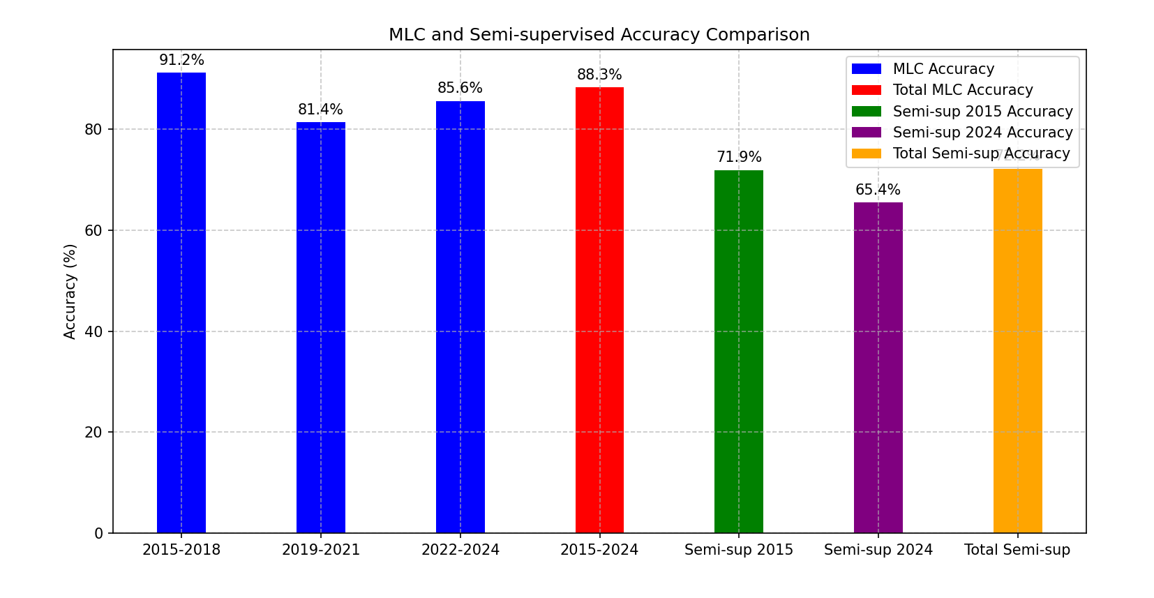
MLC and Semi-Supervised Accuracy Comparison
MLC Accuracy:
2015–2018: 91.2%
2019–2021: 81.4%
2022–2024: 85.6%
Overall (2015–2024): 88.3%
Semi-Supervised Accuracy:
2015: 71.9%
2024: 65.4%
Overall: 69.2%
MLC consistently outperforms semi-supervised method across all periods.
Accuracy gap indicates MLC’s greater reliability in classification tasks over time.

Slide 34
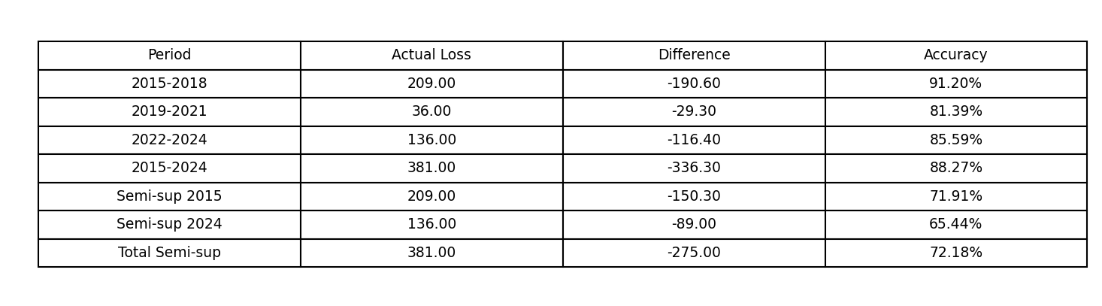
OUTPUT ACCURACY SUMMARY
MLC (Maximum Likelihood Classification):
Highest accuracy observed: 91.20% (2015–2018)
Total accuracy (2015–2024): 88.27%
Cumulative difference in area loss: −336.30 hectares
Semi-supervised Method:
2015 Accuracy: 71.91%
2024 Accuracy: 65.44%
Total accuracy: 72.18%
Cumulative difference in area loss: −275.00 hectares

Slide 35
OUTCOMES
Utilize advanced satellite imagery and Machine Learning/deep learning algorithms.
Generate highly detailed maps of deforestation patterns and hotspots.
Identify priority areas for conservation and intervention.
Contribute to understanding drivers and dynamics of deforestation.
Serve as valuable resources for policymakers, researchers, and communities.
The results highlight the difference in deforestation patterns from 2015 to 2024 at 3-year of intervals.
This comparison helps identify trends, underlying causes, and the overall impact of deforestation during the
studied period.

Slide 36
CONCLUSION
Higher Accuracy across all periods, consistently above 80%.
More precise detection of land cover changes, aligning closely with actual loss.
Although semi-supervised methods had slightly less area discrepancy, the accuracy trade-off is significant.
MLC is more reliable for both short-term and long-term analysis in deforestation mapping.

